Slide 1
THz Ryegrass Hydration Measurement
16-April Report
Reporter: Jialu Xing
Supervisor: Dominik Vogt

Slide 2
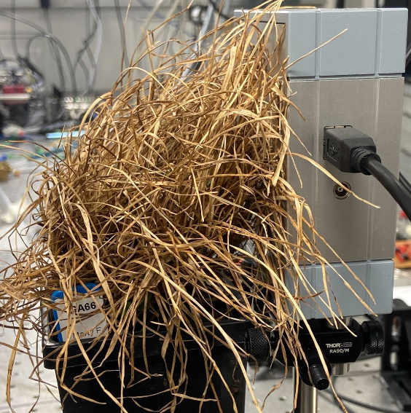
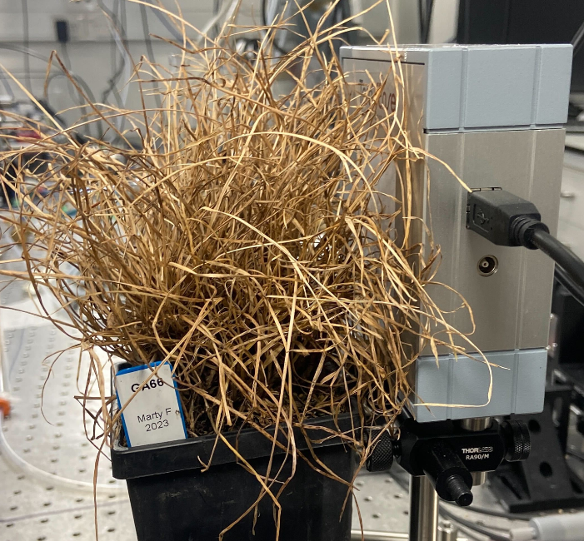
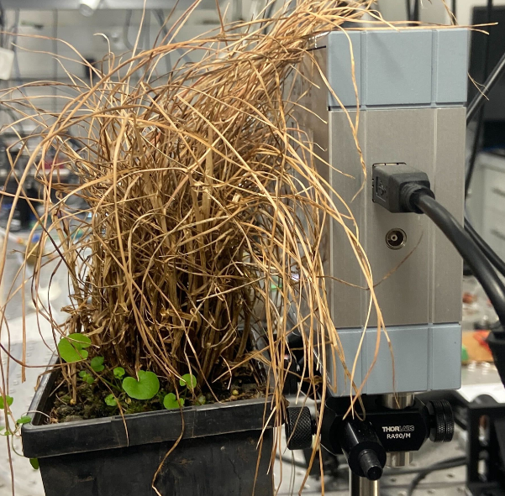
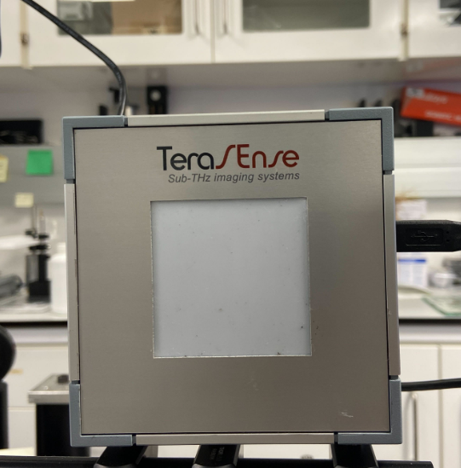
Recap: Empty pixel
Dry plants GA66-1:
Average saturated attenuation: 8.875 dB Average pixel value: 0.49133940625
Dry plants GA66-2:
Average saturated attenuation: 9.1125dB Average pixel value: 0.491919609375
Dry plants One50:
Average saturated attenuation: 6.45625 dB
Average pixel value: 0.493481125
Empty screen:
Average saturated attenuation: 10.49375 dB
Average pixel value: 0.49057878125
Two GA66 plants have similar data, so saturated attenuation may be related with specious.

Slide 3
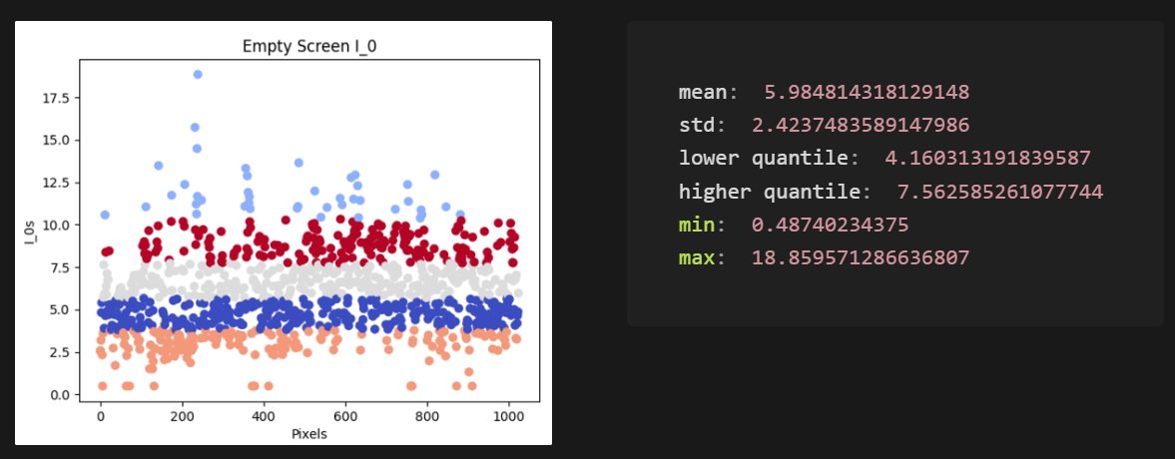
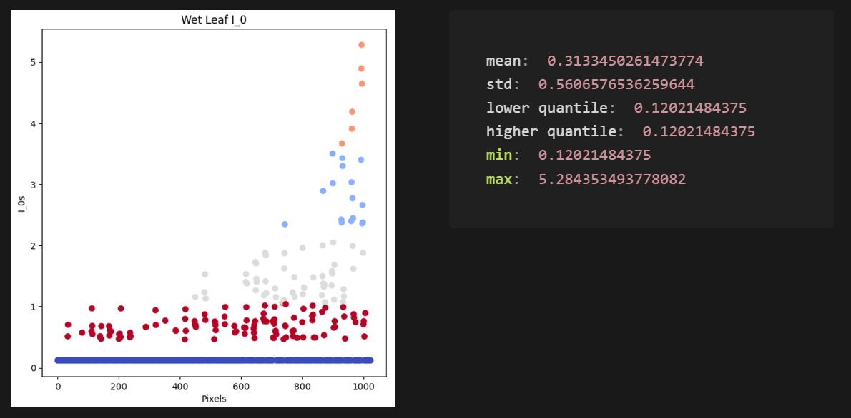
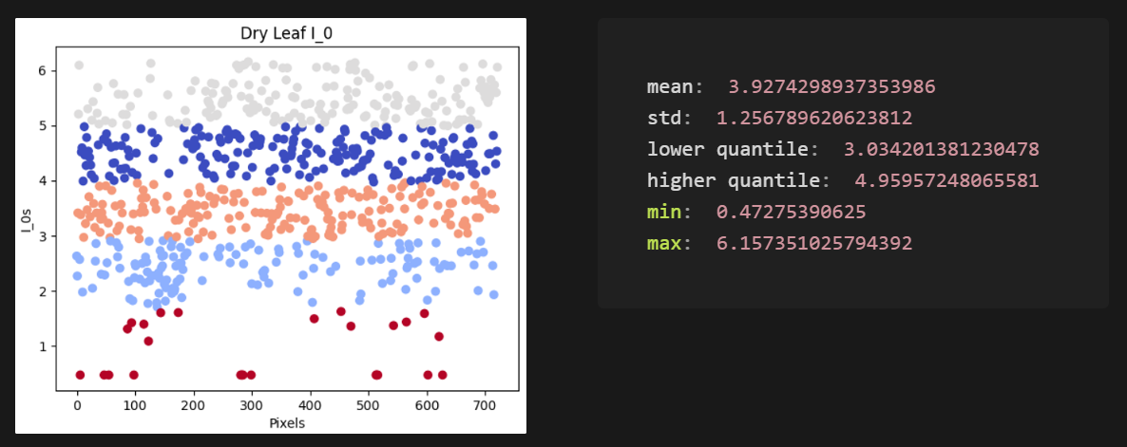
Recap: Empty pixel
I_0 = 10^(dB/10)*pixel_value
Set the I_0 threshold to 4.16
pixel_value < 4.16: pixel with leaf
pixel_value < 4.16: empty pixel

Slide 4
Recap: Long scan time
Scan process
Decrease attenuation
Check for saturated pixels and store the data
If still have un-saturated pixel
About 3-4 minutes to take one scan

Slide 5
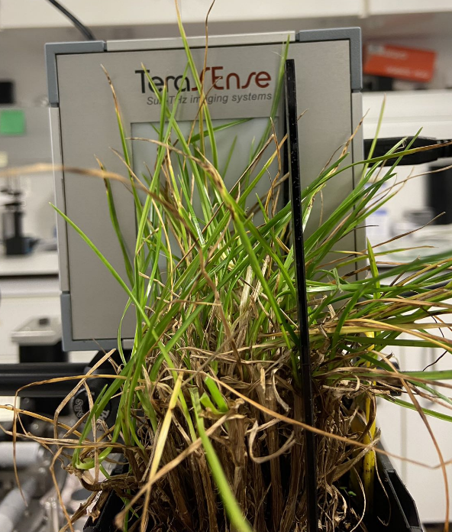
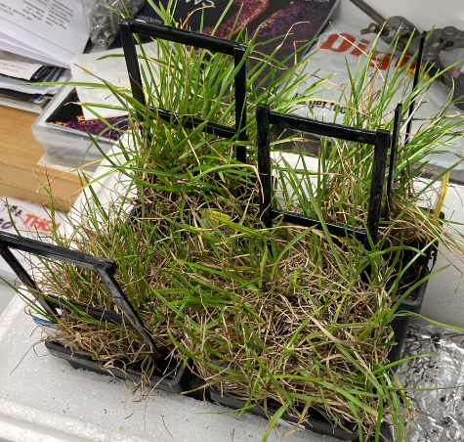
Plant Experiment
Repeat the leaf expr but on real plants
Plant experiment setup

Slide 6
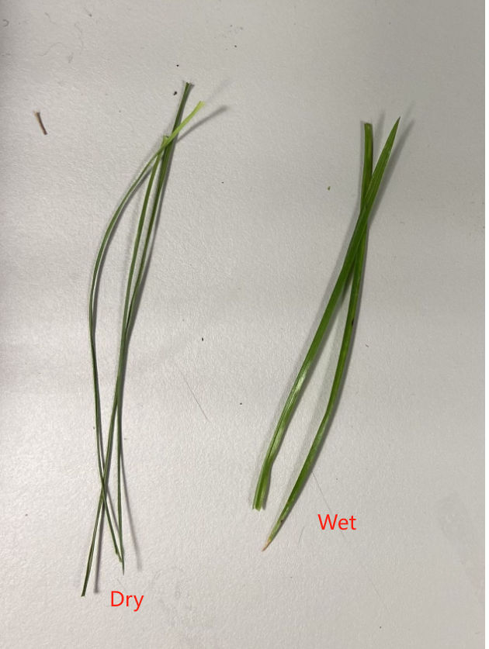
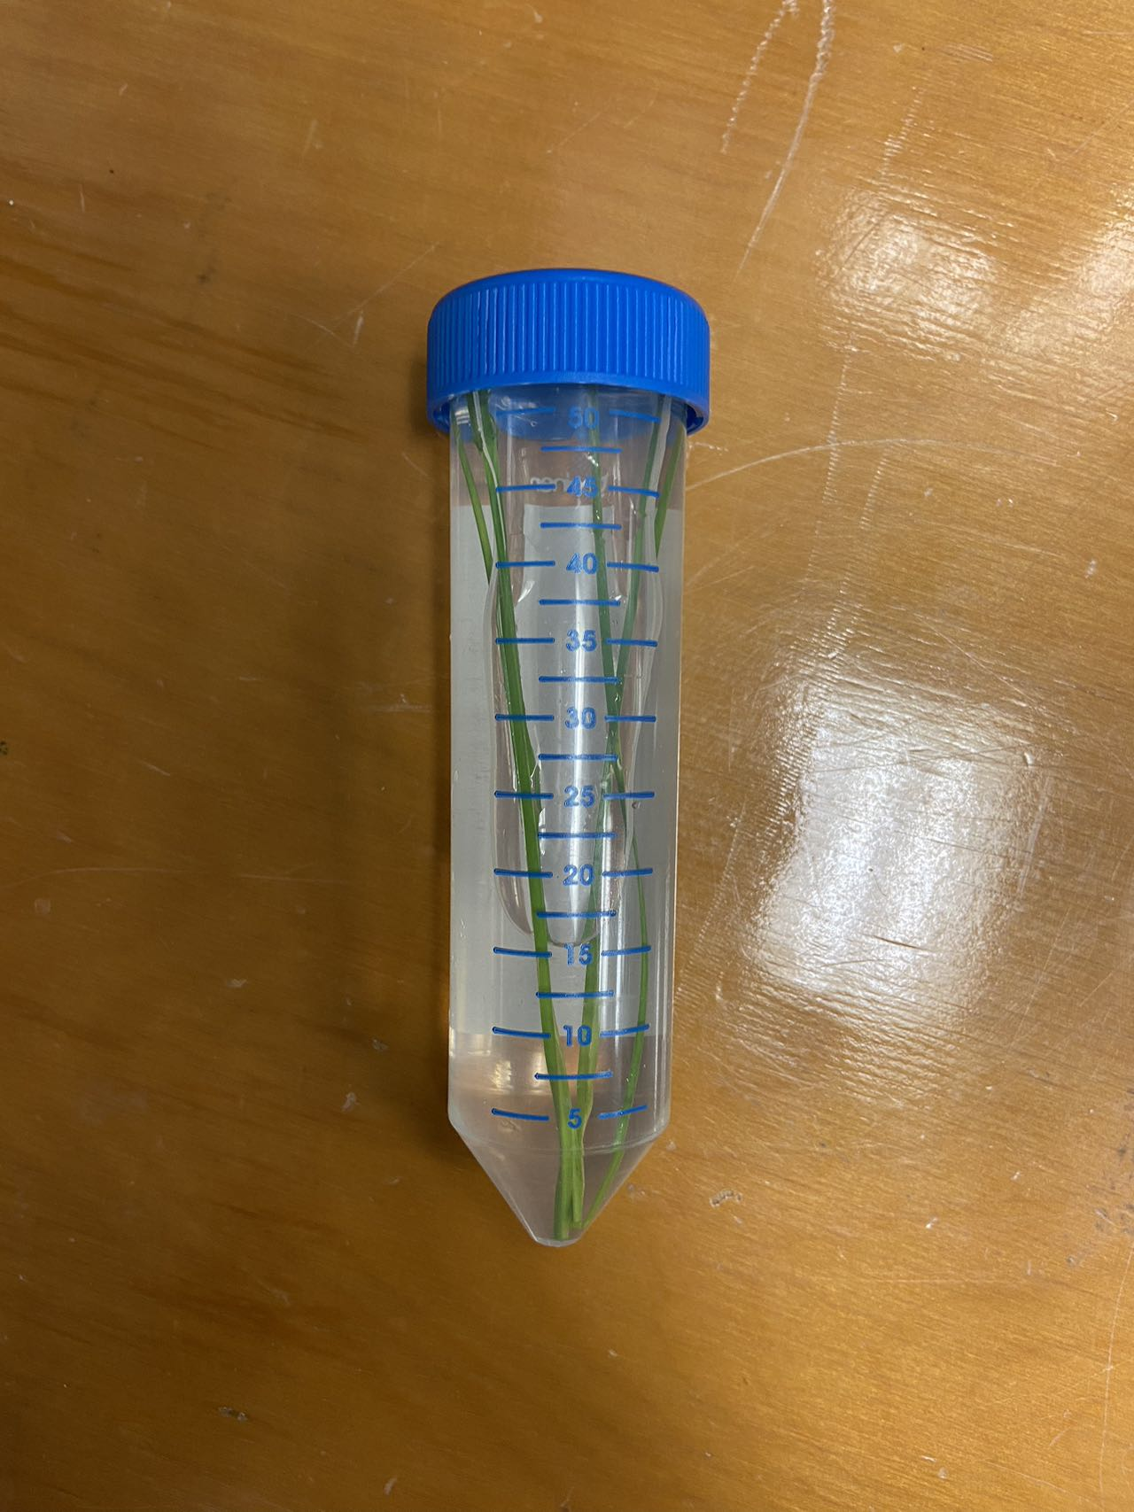
Plant Experiment
Repeat the leaf expr but on real plants
Plant experiment setup

Slide 7
Plant Experiment
Experiment process
Repeat until plants dry up
Leaf with around 95% RWC
Cut some leaf from the plant
Take THz data scan
Leave for one day to de-hydrate
Weight the leaf
W
Fully hydrate the leaf
Calculate the gravimetric RWC
Weight the fully hydrated leaf
TW
When dry up
Fully de-hydrate the leaf
Calculate the THz RWC
Weight the dry leaf
DW

Slide 8
Plant Experiment
Result

Slide 9
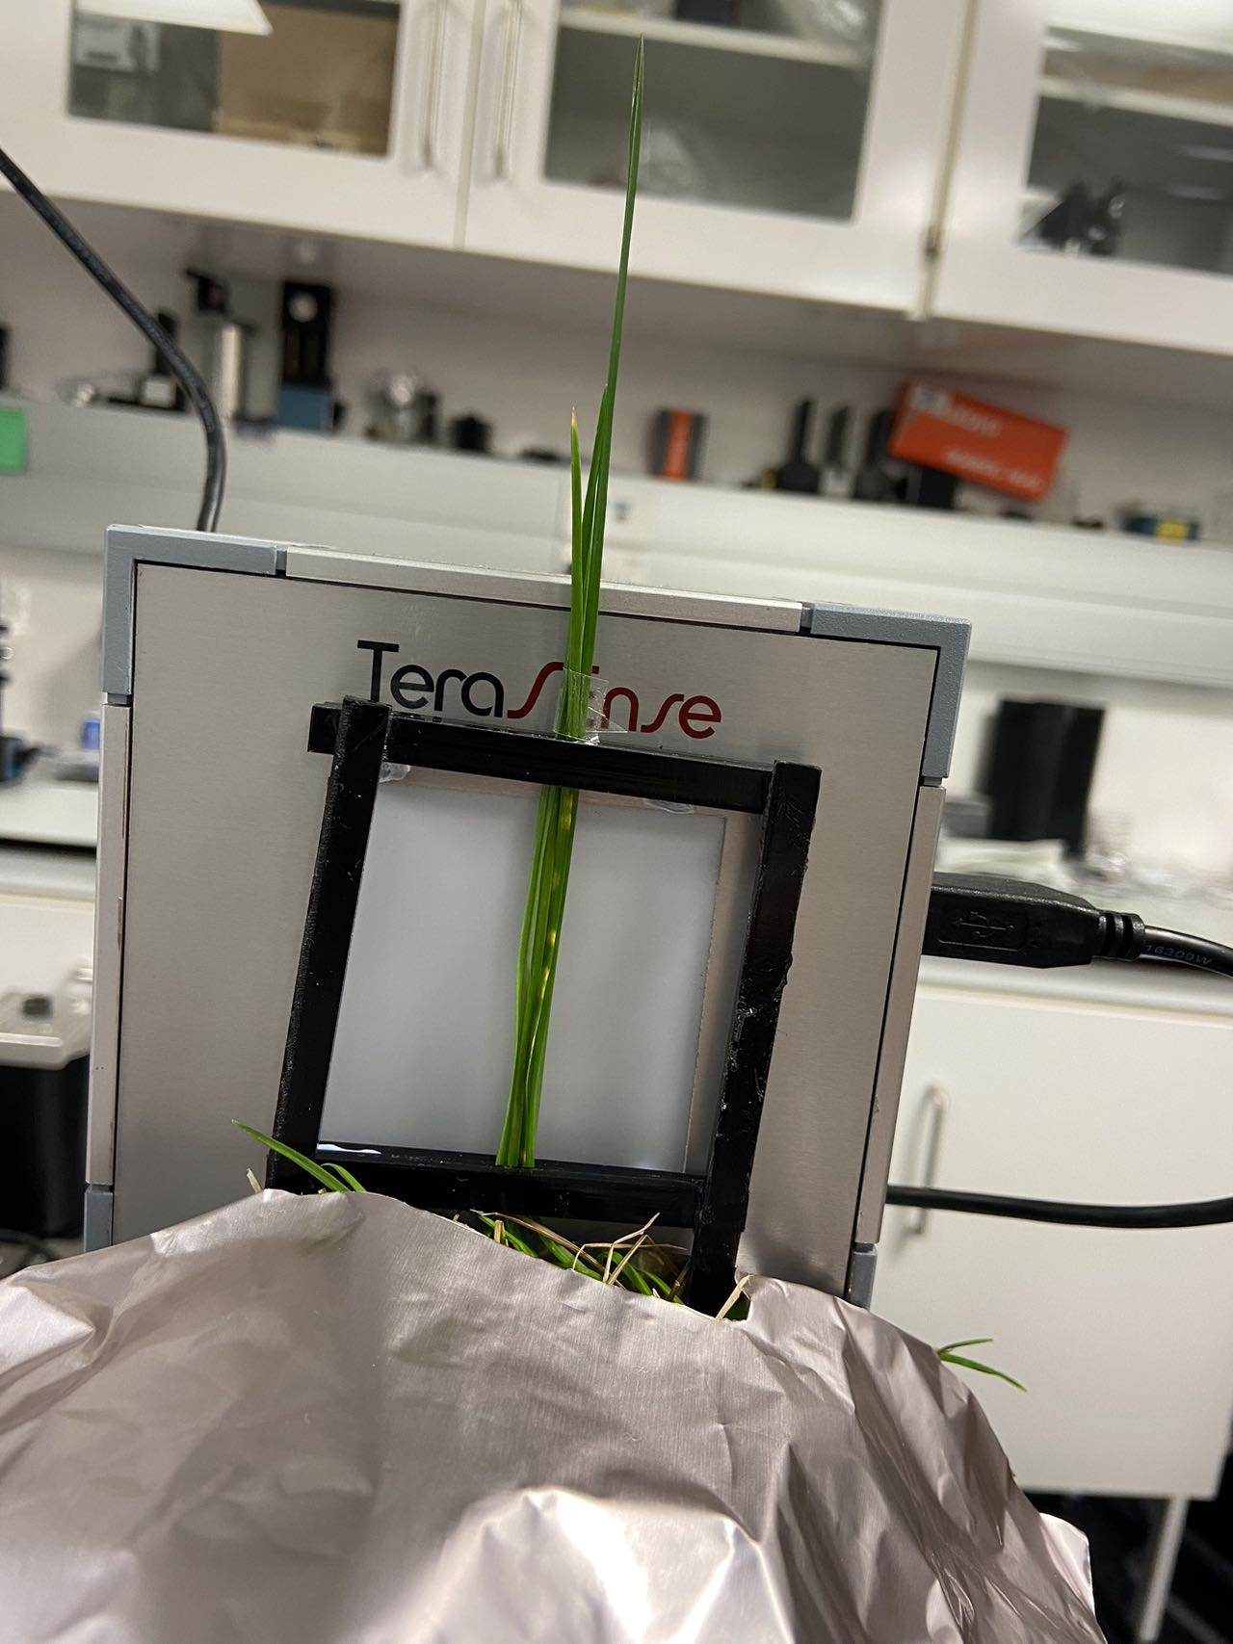
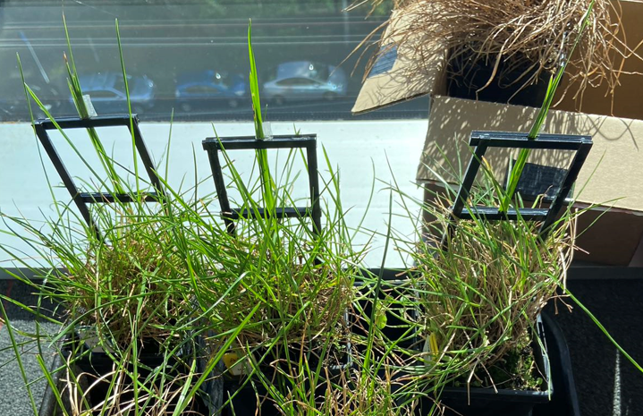
Other trails
Fixed leaves

Slide 10
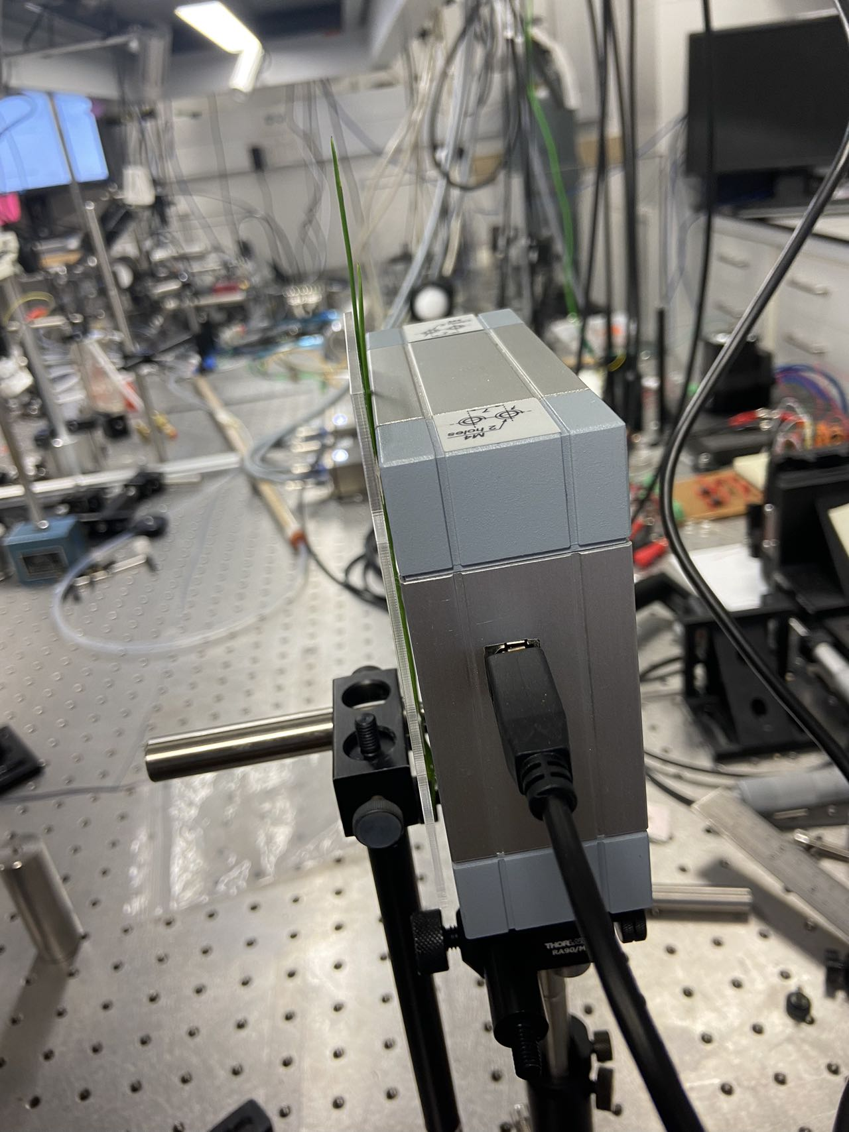
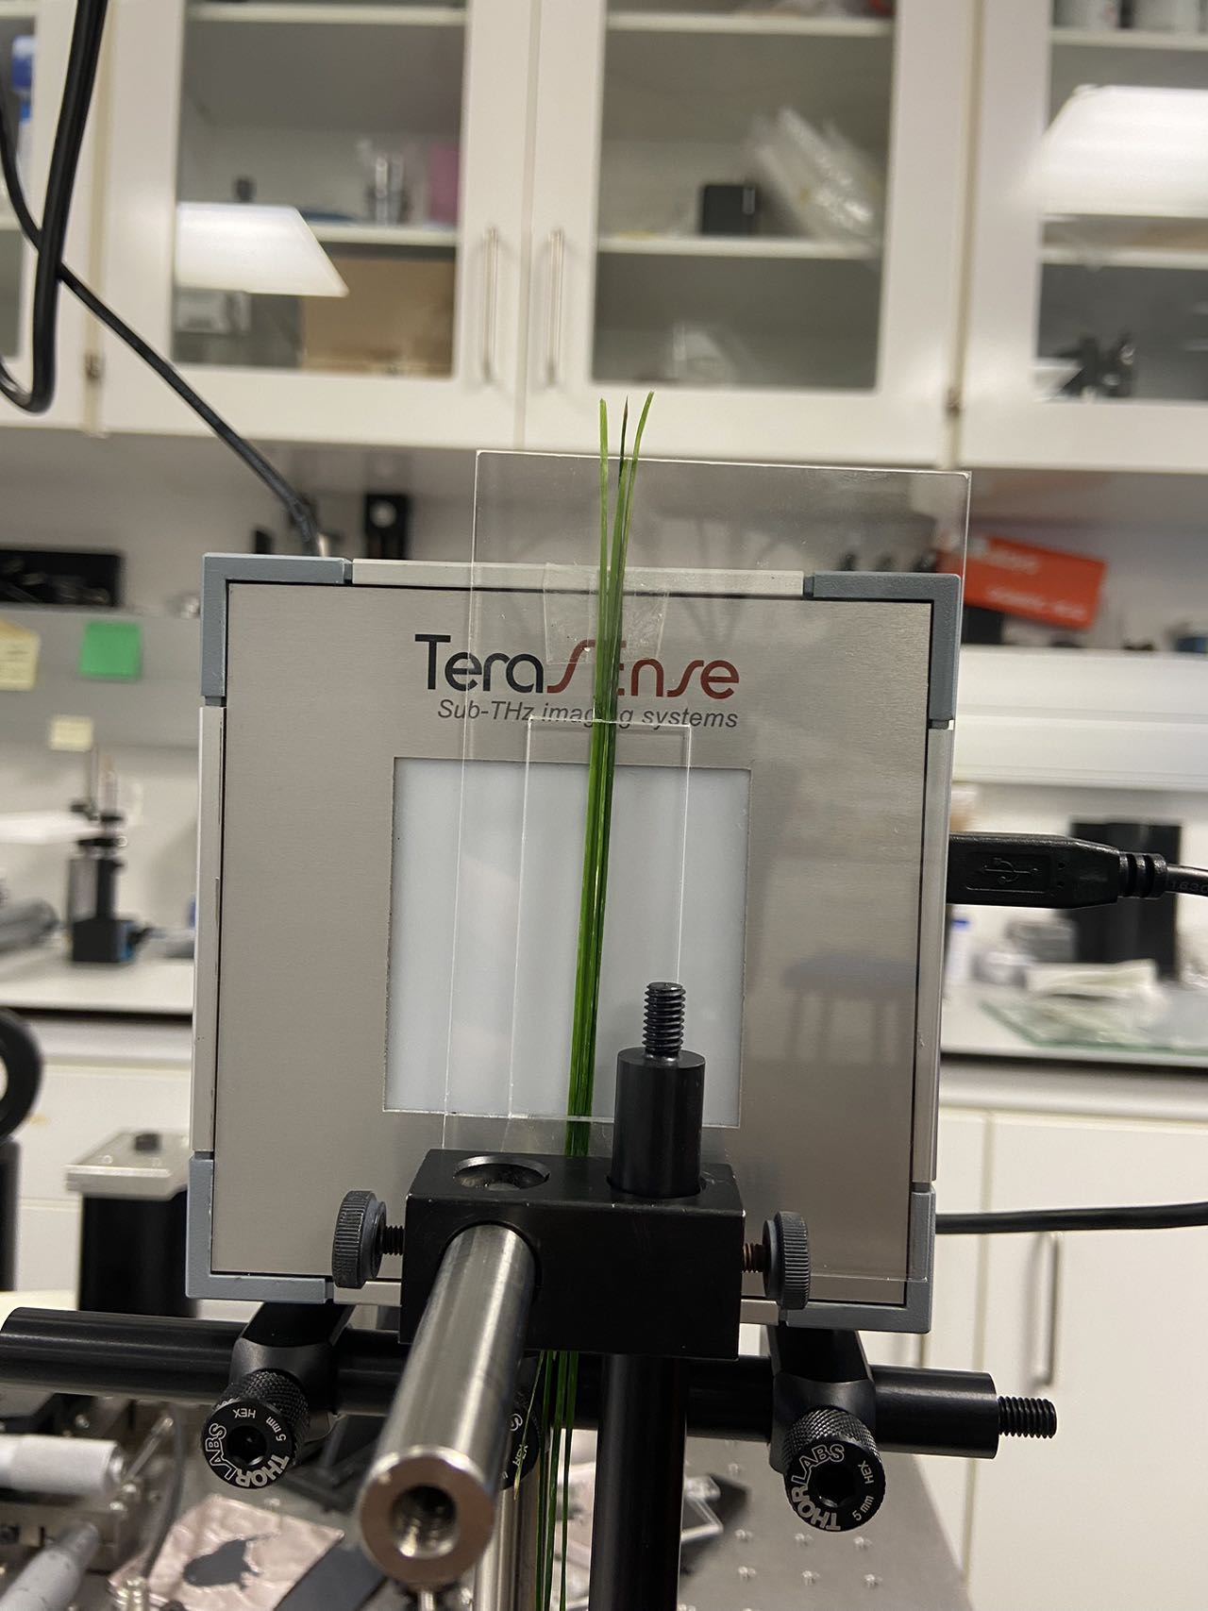
Other trails
Cut leaves

Slide 11
Problems
To fully exclude un-wanted pixels(empty pixel)
Get data first and then use attenuation threshold to exclude outliers
or
Check how the pixels are aligned with the screen, and exclude empty pixel before collecting data with real images

Slide 12
Outlook
Solve pixels with no leaves issue.
Collect complete plant experiment data.

Slide 13
Thank you!

